Slide 1
Layout
Avec MAUI

Slide 2
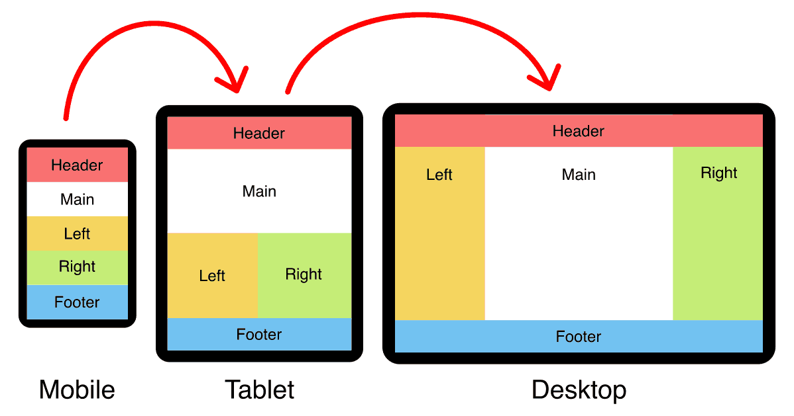
Layout => Mise en page

Slide 3
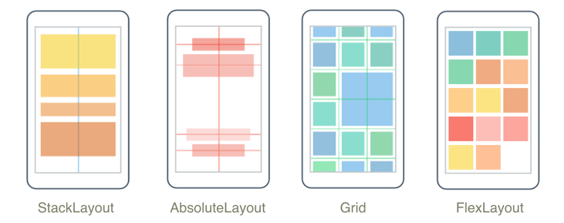
Layout de base avec MAUI
Les mises en page sont comme des poupées russes, chaque élément d’un layout, peut lui-même être un autre layout…

Slide 4
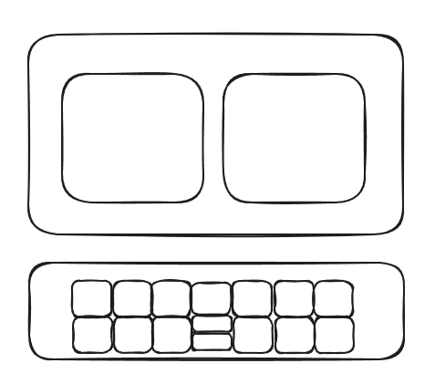
Exemple
Stack
Grid / Flex
Grid

Slide 5
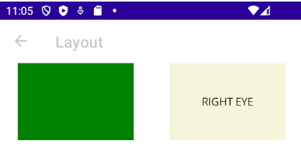
En XAML : les yeux
<VerticalStackLayout>
<FlexLayout Margin="0,0,0,10" JustifyContent="SpaceAround">
<!-- Oeil gauche -->
<BoxView HeightRequest="100" WidthRequest="150" Color="Green" />
<!-- Oeil droit -->
<Label Text="RIGHT EYE" WidthRequest="150" HeightRequest="100"
VerticalTextAlignment="Center" HorizontalTextAlignment="Center"
BackgroundColor="Beige" />
</FlexLayout>

Slide 6
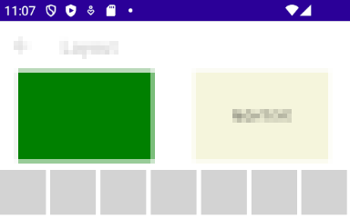
XAML: base des dents
<Grid RowSpacing="5" ColumnSpacing="5" Margin="3,0,3,0">
<Grid.RowDefinitions>
<RowDefinition Height="50" />
<RowDefinition Height="50" />
</Grid.RowDefinitions>
<Grid.ColumnDefinitions>
<ColumnDefinition />
<ColumnDefinition />
<ColumnDefinition />
<ColumnDefinition />
<ColumnDefinition />
<ColumnDefinition />
<ColumnDefinition />
</Grid.ColumnDefinitions>
<!-- Dents du haut -->
<BoxView Color="LightGray" Grid.Row="0" Grid.Column="0" />
<BoxView Color="LightGray" Grid.Row="0" Grid.Column="1" />
<BoxView Color="LightGray" Grid.Row="0" Grid.Column="2" />
<BoxView Color="LightGray" Grid.Row="0" Grid.Column="3" />
<BoxView Color="LightGray" Grid.Row="0" Grid.Column="4" />
<BoxView Color="LightGray" Grid.Row="0" Grid.Column="5" />
<BoxView Color="LightGray" Grid.Row="0" Grid.Column="6" />
<BoxView Color="LightGray" Grid.Row="0" Grid.Column="7" />

Slide 7

XAML: dents du bas
<!-- Dents du bas -->
<BoxView Color="LightGray" Grid.Row="1" />
<BoxView Color="LightGray" Grid.Row="1" Grid.Column="1" />
<BoxView Color="LightGray" Grid.Row="1" Grid.Column="2" />
<!-- dent cassée -->
<Grid Grid.Row="1" Grid.Column="3" ColumnSpacing="2">
<Grid.RowDefinitions>
<RowDefinition Height="50" />
</Grid.RowDefinitions>
<Grid.ColumnDefinitions>
<ColumnDefinition />
<ColumnDefinition />
</Grid.ColumnDefinitions>
<BoxView Color="LightSlateGray" Grid.Row="0" />
<BoxView Color="LightSlateGray" Grid.Row="0" Grid.Column="1" />
</Grid>
<!-- Reste des dents du bas -->
<BoxView Color="LightGray" Grid.Row="1" Grid.Column="4" />
<BoxView Color="LightGray" Grid.Row="1" Grid.Column="5" />
<BoxView Color="LightGray" Grid.Row="1" Grid.Column="6" />
</Grid>

Slide 8
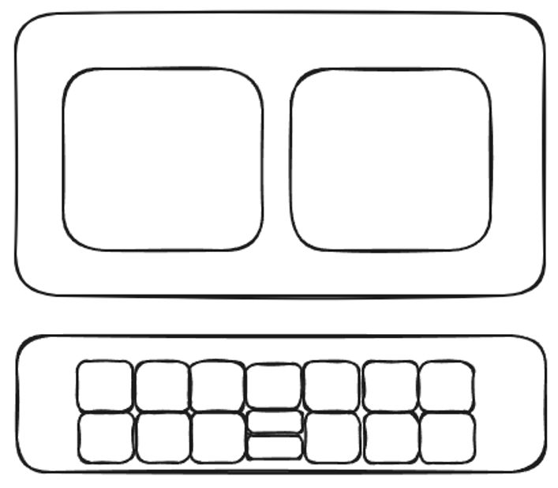
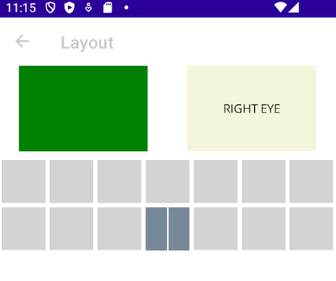
Maquette VS App

Slide 9
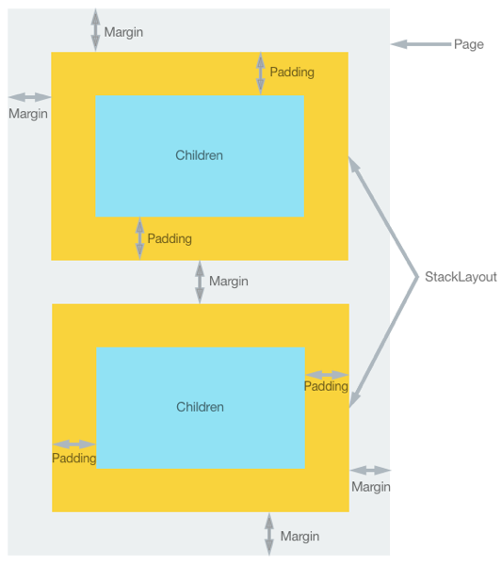
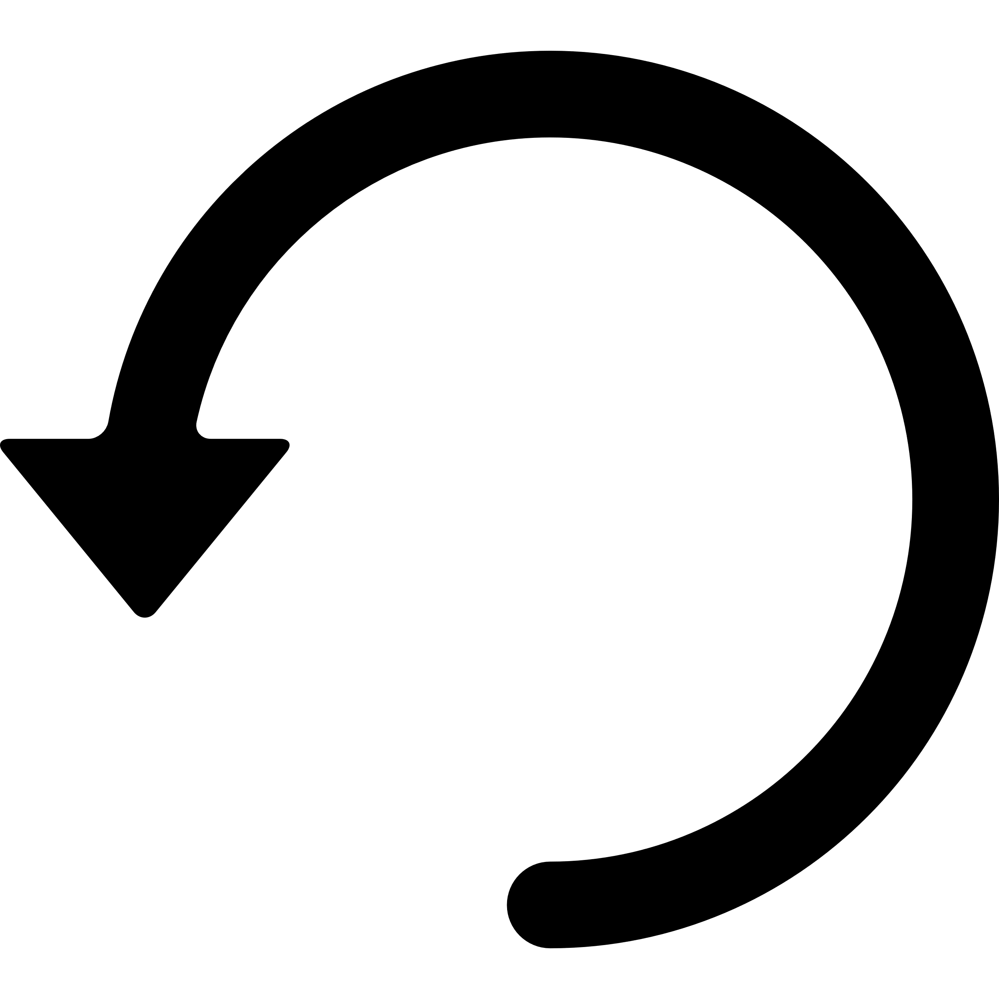
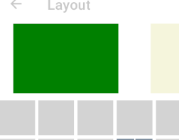
Espaces entre les éléments (AKA CSS)
Espaces et finesses entre les éléments
Margin / Padding
4 valeurs
1,2,3,4
TOP
LEFT
RIGHT
<FlexLayout Margin="0,0,0,10">
BOTTOM
BOTTOM

Slide 10
En résumé
4 layouts de base
Stack
Grid
Flex
Absolute (À éviter ou alors à recalculer manuellement…)
Fonctionnement analogue au CSS
Layouts imbricables
Utilisation de margin/padding pour les espacements
Possibilité de "justifier" les éléments (JustifyContent)

Slide 11
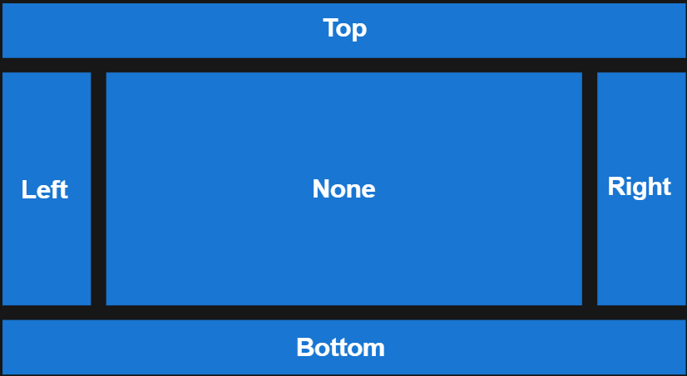
Extensions
Avec le toolkit MAUI (Documentation de .NET MAUI Community Toolkit - Community Toolkits for .NET | Microsoft Learn)
DockLayout
UniformLayout

Slide 12
Défi
Indice: https://learn.microsoft.com/en-us/dotnet/maui/user-interface/layouts/stacklayout?view=net-maui-8.0

